Slide 1

eventify
FA19 CMPE-272-01
Akshit Ahuja
Ayushman Mittal
Chaitanya Naik
Naman Agrawal

Slide 2
Why Eventify?
Lead generation
Eventify provides Valuable lead reports determining prospect customers/investors for various vendors at an event.
efficient event management
Eventify provides hassle-free end-to-end event management. Event organizers can manage various vendors and attendees using the online portal and hardware .
Track attendees
STAY INFORMED ABOUT TOTAL COUNT OF USERS ATTENDING THE EVENT, THE STALLS OR KEYNOTES THEY ARE MOST INTERESTED IN AND HELP ATTENDEES NAVIGATE USING QR CODES AND MOBILE APP

Slide 3
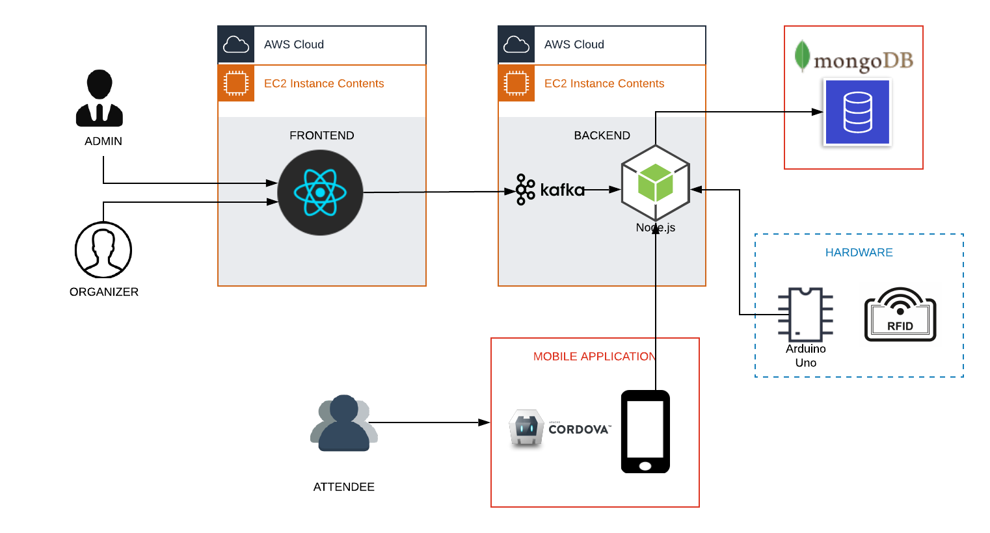
Architecture & Flow
Notes:
Consider talking about:
Formally solicited proposals
Informally solicited business proposal

Slide 4
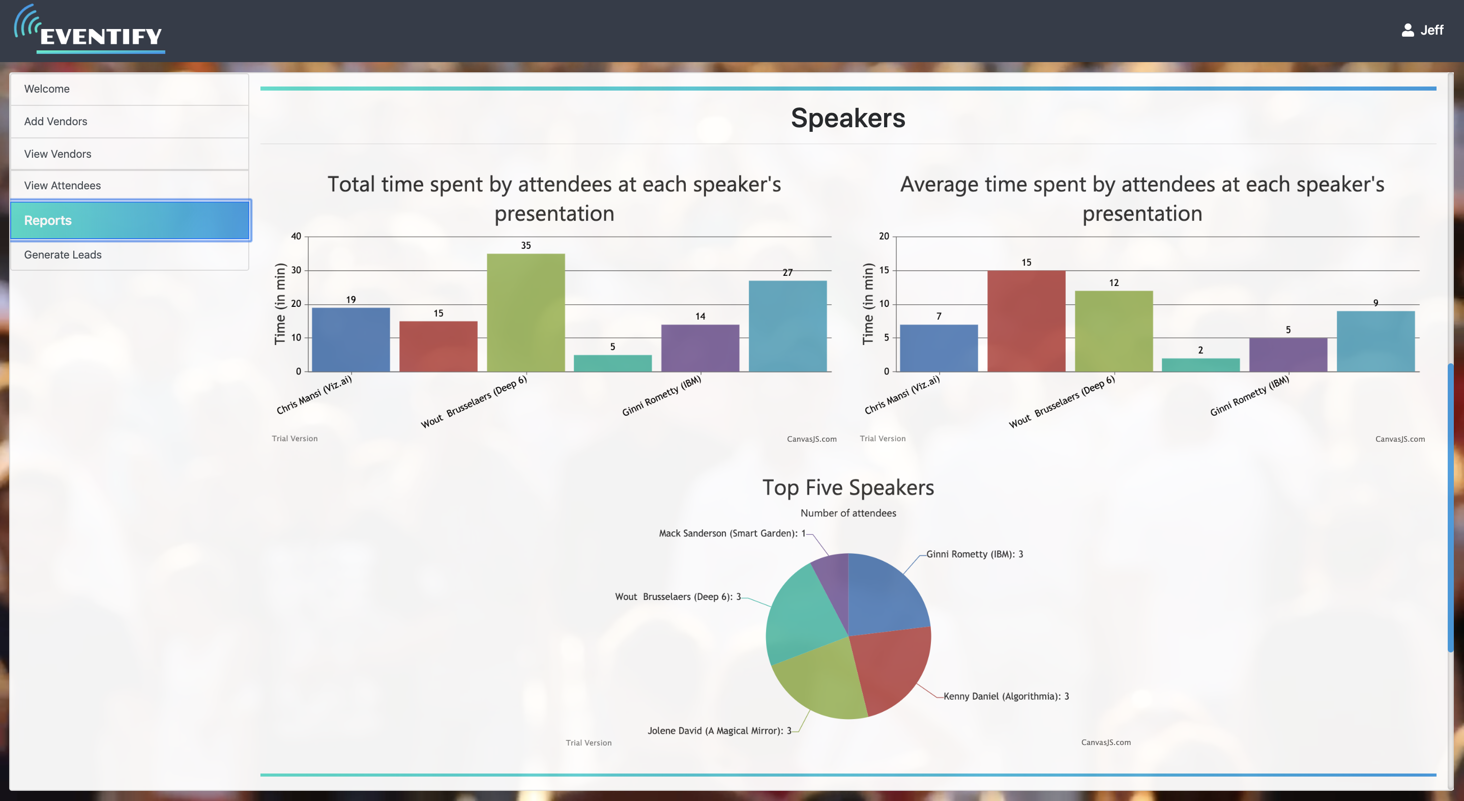
VISUAL ANALYTICS FOR ORGANIZERS
Notes:
Consider talking about:
The process of proposal management

Slide 5
QUANTIFICATION

Slide 6
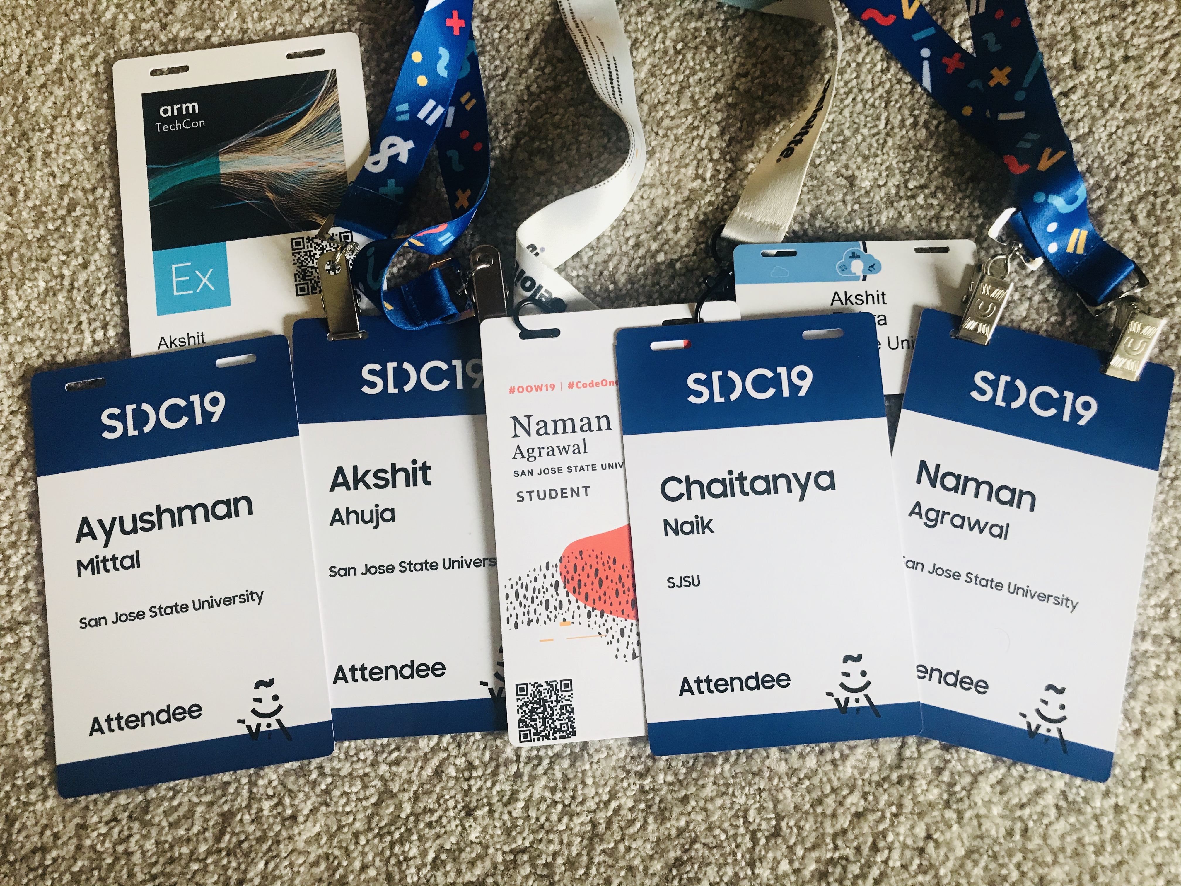
Groundwork
EVENTS WE ATTENDED
Samsung Developers Conference ’19
Oracle OpenWorld ‘19
AI Dev World ’19 and many more!
Notes:
Consider talking about:
Internal proposals
Sole-source contract
Format
Title
Abstract
Statement and method
Budget
Biographical information
Sponsor values
Applicant credibility

